Slide 1

Set and Frozen Set
COMP 6502 + COMP 6056
By Ida Bagus Kerthyayana Manuaba
Friday, 23 Oct 2020

Slide 2

Agenda
Review:
Dictionary
Set
FrozenSet

Slide 3
Learning Outcome
COMP 6502 - I2P:
Apply principles of Python programming in designing and developing a program
Translate a specified algorithm into correct self-documented Python code using generally accepted programming style.
Identify programming errors and solution requirements toward the problem
COMP 6506 - PDM:
Explain the basic principles of computing and programming
Design algorithmic solutions to problems.

Slide 4
Session Outcomes
Understanding sequence data type
Understand how to implement set and frozenSet with example

Slide 5
Review:
Python Dictionary

Slide 6

Let’s Play a bit

Slide 7
Python Set and Frozen Set

Slide 8
Python Set
A set is an unordered collection of items. Every set element is unique (no duplicates) and must be immutable (cannot be changed).
However, a set itself is mutable. We can add or remove items from it.
Sets can also be used to perform mathematical set operations like union, intersection, symmetric difference, etc.

Slide 9
How to create Python Set
A set is created by placing all the items (elements) inside curly braces {}, separated by comma, or by using the built-in set() function.
Almost similar like Dictionary
It can have any number of items and they may be of different types (integer, float, tuple, string etc.).
But a set cannot have mutable elements like lists, sets or dictionaries as its elements.

Slide 10
# Different types of sets in Python
# set of integers
my_set = {1, 2, 3}
print(my_set)
# set of mixed datatypes
my_set = {1.0, "Hello", (1, 2, 3)}
print(my_set)
# set cannot have duplicates
# Output: {1, 2, 3, 4}
my_set = {1, 2, 3, 4, 3, 2}
print(my_set)
# we can make set from a list
# Output: {1, 2, 3}
my_set = set([1, 2, 3, 2])
print(my_set)
# set cannot have mutable items # here [3, 4] is a mutable list
# this will cause an error.
my_set = {1, 2, [3, 4]}

Slide 11
Creating empty set?
Empty curly braces {} will make an empty dictionary in Python. To make a set without any elements, we use the set() function without any argument.
# Distinguish set and dictionary while creating empty set
# initialize a with {}
a = {}
# check data type of a
print(type(a))
# initialize a with set()
a = set()
# check data type of a
print(type(a))

Slide 12
Modifying a set in Python
Sets are mutable. However, since they are unordered, indexing has no meaning.
We cannot access or change an element of a set using indexing or slicing. Set data type does not support it.
We can add a single element using the add() method, and multiple elements using the update() method.
The update() method can take tuples, lists, strings or other sets as its argument. In all cases, duplicates are avoided.

Slide 13
# initialize my_set
my_set = {1, 3}
print(my_set)
# if you uncomment line below, you will get an error TypeError: 'set' object does not support indexing
# my_set[0]
# add an element
# Output: {1, 2, 3}
my_set.add(2)
print(my_set)
# add multiple elements
# Output: {1, 2, 3, 4}
my_set.update([2, 3, 4])
print(my_set)
# add list and set
# Output: {1, 2, 3, 4, 5, 6, 8}
my_set.update([4, 5], {1, 6, 8})
print(my_set)

Slide 14
Removing elements from a set
A particular item can be removed from a set using the methods discard() and remove().
The only difference between the two is that the discard() function leaves a set unchanged if the element is not present in the set.
On the other hand, the remove() function will raise an error in such a condition (if element is not present in the set).

Slide 15
# Difference between discard() and remove()
# initialize my_set
my_set = {1, 3, 4, 5, 6}
# discard an element
# Output: {1, 3, 5, 6}
my_set.discard(4)
# remove an element
# Output: {1, 3, 5}
my_set.remove(6)
# discard an element not present in my_set
# Output: {1, 3, 5}
my_set.discard(2)
# remove an element not present in my_set you will get an error.
# Output: KeyError
my_set.remove(2)

Slide 16
Similarly, we can remove and return an item using the pop() method.
Since set is an unordered data type, there is no way of determining which item will be popped. It is completely arbitrary.
We can also remove all the items from a set using the clear() method.
# initialize my_set
# Output: set of unique elements
my_set = set("HelloWorld")
# pop an element
# Output: random element
print(my_set.pop())
# pop another element
my_set.pop()
print(my_set)
# clear my_set
# Output: set()
my_set.clear()
print(my_set)

Slide 17
Python Set Operations
Sets can be used to carry out mathematical set operations like union, intersection, difference and symmetric difference. We can do this with operators or methods.

Slide 18
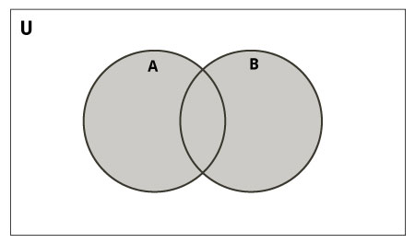
Union operation
Let us consider the following two sets for the following operations.
>>> A = {1, 2, 3, 4, 5}
>>> B = {4, 5, 6, 7, 8}
Union of A and B is a set of all elements from both sets.

Slide 19
Union is performed using | operator. Same can be accomplished using the union() method.
# Set union method # initialize A and B
A = {1, 2, 3, 4, 5} B = {4, 5, 6, 7, 8}
# use | operator
# Output: {1, 2, 3, 4, 5, 6, 7, 8}
print(A | B)
Or You could use union() method
# use union function
>>> A.union(B)
{1, 2, 3, 4, 5, 6, 7, 8}
# use union function on B
>>> B.union(A)
{1, 2, 3, 4, 5, 6, 7, 8}

Slide 20
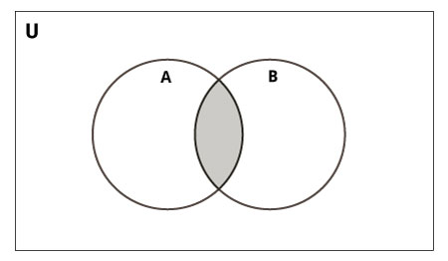
Intersection Operation
Intersection of A and B is a set of elements that are common in both the sets.
Intersection is performed using & operator. Same can be accomplished using the intersection() method.

Slide 21
# Intersection of sets
# initialize A and B
A = {1, 2, 3, 4, 5}
B = {4, 5, 6, 7, 8}
# use & operator
# Output: {4, 5}
print(A & B)
Or you could do it using intersection() method
# use intersection function on A
>>> A.intersection(B)
{4, 5}
# use intersection function on B
>>> B.intersection(A)
{4, 5}

Slide 22
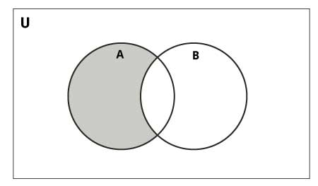
Different Operation
Difference of the set B from set A, or (A - B), is a set of elements that are only in A but not in B.
Similarly, B - A is a set of elements in B but not in A.
Difference is performed using - operator. Same can be accomplished using the difference() method.

Slide 23
# Difference of two sets
# initialize A and B
A = {1, 2, 3, 4, 5}
B = {4, 5, 6, 7, 8}
# use - operator on A
print(A - B) # Output: {1, 2, 3}
print(B - A ) # Output: {6, 7, 8 }
You could use difference() method also
# use difference function on A
>>> A.difference(B)
{1, 2, 3}
# use difference function on B
>>> B.difference(A)
{8, 6, 7}

Slide 24
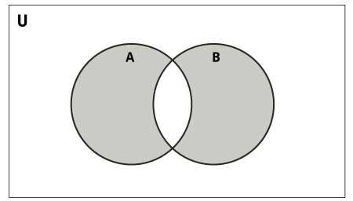
Symmetric Difference Operation
Symmetric Difference of A and B is a set of elements in A and B but not in both (excluding the intersection).
Symmetric difference is performed using ^ operator. Same can be accomplished using the method symmetric_difference().

Slide 25
# Symmetric difference of two sets
# initialize A and B
A = {1, 2, 3, 4, 5}
B = {4, 5, 6, 7, 8}
# use ^ operator
# Output: {1, 2, 3, 6, 7, 8}
print(A ^ B)
Try also using symmetric_difference() method
# use symmetric_difference function on A
>>> A.symmetric_difference(B)
{1, 2, 3, 6, 7, 8}
# use symmetric_difference function on B
>>> B.symmetric_difference(A)
{1, 2, 3, 6, 7, 8}

Slide 26
Other Python Set Methods
Method | Description
add() | Adds an element to the set
clear() | Removes all elements from the set
copy() | Returns a copy of the set
difference() | Returns the difference of two or more sets as a new set
difference_update() | Removes all elements of another set from this set
discard() | Removes an element from the set if it is a member. (Do nothing if the element is not in set)
intersection() | Returns the intersection of two sets as a new set
intersection_update() | Updates the set with the intersection of itself and another
isdisjoint() | Returns True if two sets have a null intersection
issubset() | Returns True if another set contains this set
issuperset() | Returns True if this set contains another set
pop() | Removes and returns an arbitrary set element. Raises KeyError if the set is empty
remove() | Removes an element from the set. If the element is not a member, raises a KeyError
symmetric_difference() | Returns the symmetric difference of two sets as a new set
symmetric_difference_update() | Updates a set with the symmetric difference of itself and another
union() | Returns the union of sets in a new set
update() | Updates the set with the union of itself and others

Slide 27
Other Set Operations
Set Membership Test and Iterating Through a Set

Slide 28
Set Membership Test
We can test if an item exists in a set or not, using the in keyword.
# in keyword in a set
# initialize my_set
my_set = set("apple")
# check if 'a' is present
# Output: True print('a' in my_set)
# check if 'p' is present
# Output: False
print('p' not in my_set)

Slide 29
Iterating Through a Set
We can iterate through each item in a set using a for loop.
>>> for letter in set(”bagus"):
... print(letter)
...
b
a
g
u
s

Slide 30
Built-in Functions with Set
Function | Description
all() | Returns True if all elements of the set are true (or if the set is empty).
any() | Returns True if any element of the set is true. If the set is empty, returns False.
enumerate() | Returns an enumerate object. It contains the index and value for all the items of the set as a pair.
len() | Returns the length (the number of items) in the set.
max() | Returns the largest item in the set.
min() | Returns the smallest item in the set.
sorted() | Returns a new sorted list from elements in the set(does not sort the set itself).
sum() | Returns the sum of all elements in the set.

Slide 31
Python Frozenset

Slide 32
Python Frozenset
Frozenset is a new class that has the characteristics of a set, but its elements cannot be changed once assigned.
While tuples are immutable lists, frozensets are immutable sets.
Sets being mutable are unhashable, so they can't be used as dictionary keys. On the other hand, frozensets are hashable and can be used as keys to a dictionary.
Frozensets can be created using the frozenset() function.

Slide 33
This data type supports methods like copy(), difference(), intersection(), isdisjoint(), issubset(),
issuperset(), symmetric_difference() and union(). REMEMBER: Being immutable, it does not have methods that add or remove elements.
# Frozensets
# initialize A and B
>>> A = frozenset([1, 2, 3, 4])
>>> B = frozenset([3, 4, 5, 6])
>>> A.isdisjoint(B)
False
>>> A.difference(B)
frozenset({1, 2})
>>> A | B
frozenset({1, 2, 3, 4, 5, 6})
>>> A.add(3)
... AttributeError: 'frozenset' object has no attribute 'add'

Slide 34

So what we have learn today??

Slide 35
References
https://www.programiz.com/python-programming/set
https://realpython.com/python-sets/
https://www.python-course.eu/sets_frozensets.php
https://medium.com/@rkp0432/set-type-and-frozenset-in-python-3-all-functions-and-examples-a5754e9f2ab6

Slide 36
Thank you

